Slide 1

Amma Blood Bank

Slide 2

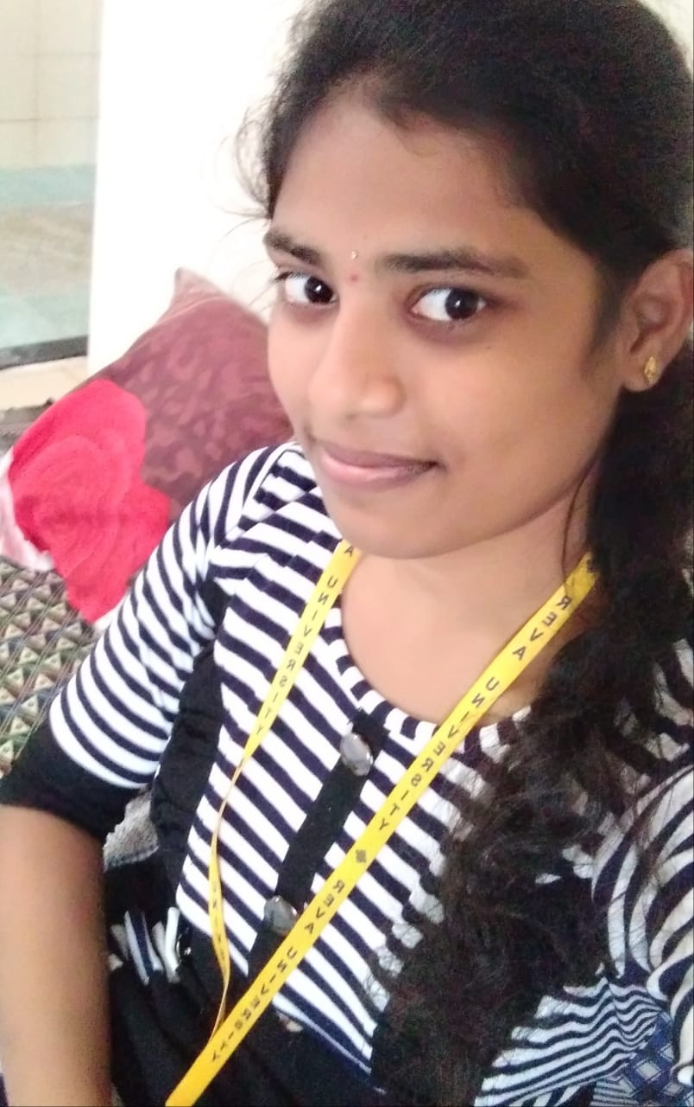
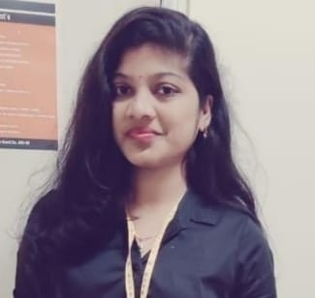

Team name:Visionaries Team members:
K.BHUVANA
K.SUPRAJA
T.HARIKA
K.DINESH

Slide 3
Abstract
The objective of this application is to developing an online Blood Donation information.
This system is used for maintain whole information about donors.
Goals [objective]
System makes the overall project management much easier and flexible.
Uploading the latest updates, allow user to see the alerts by clicking URL.
It provides the high level of security with different level of authentication.

Slide 4
Working Methodology
The person who is willing to donate blood can register here. And his/her data will be stored.
The person who is in need of blood can search the data and can find the members who are nearer to them and can approach them with their mobile number or mail , and now the donor can donate blood to the people who are in need of it.

Slide 5
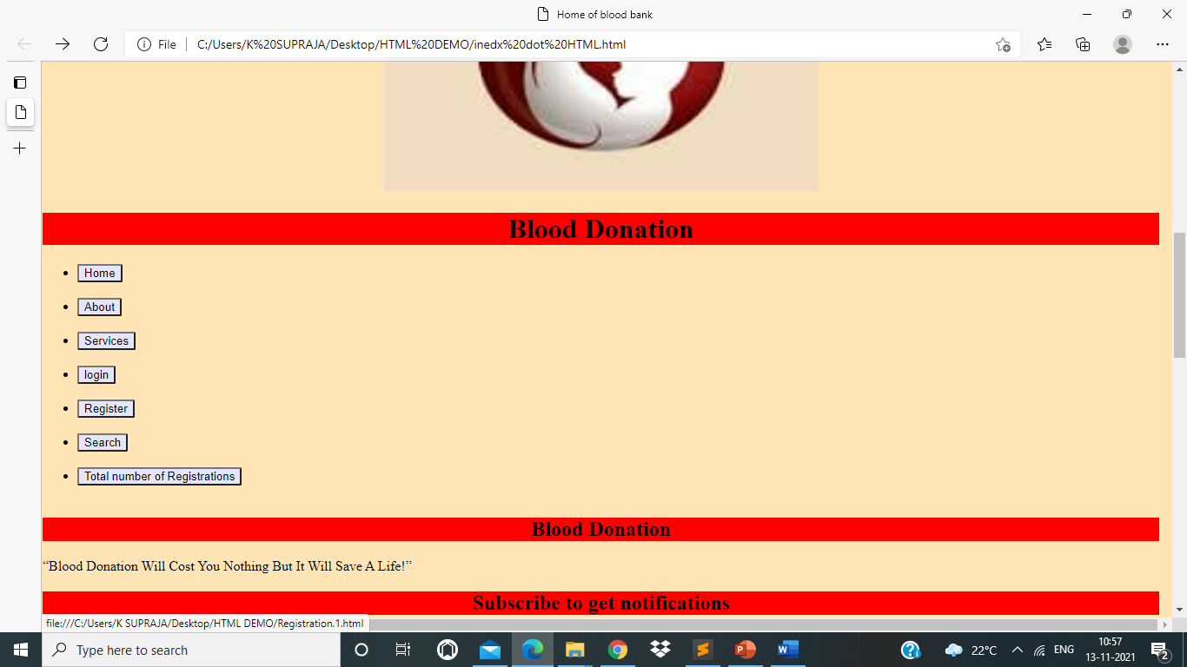
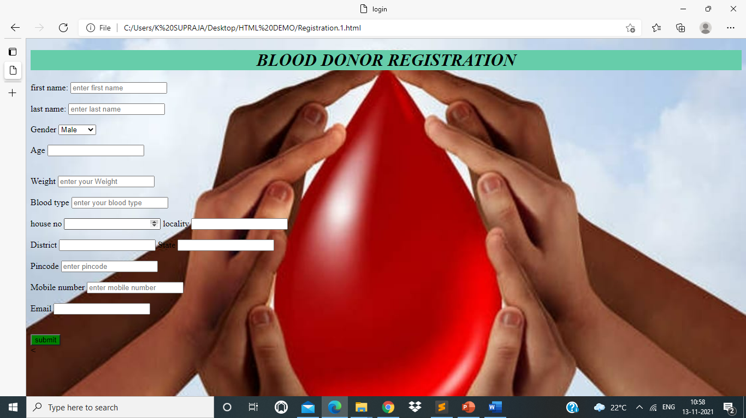
Blood donor registration The person who wants to donate blood can click on register button it redirects the person to another page for registration process.

Slide 6

After entering the data ,he / she can register as a blood donor by clicking submit in registration portal

Slide 7
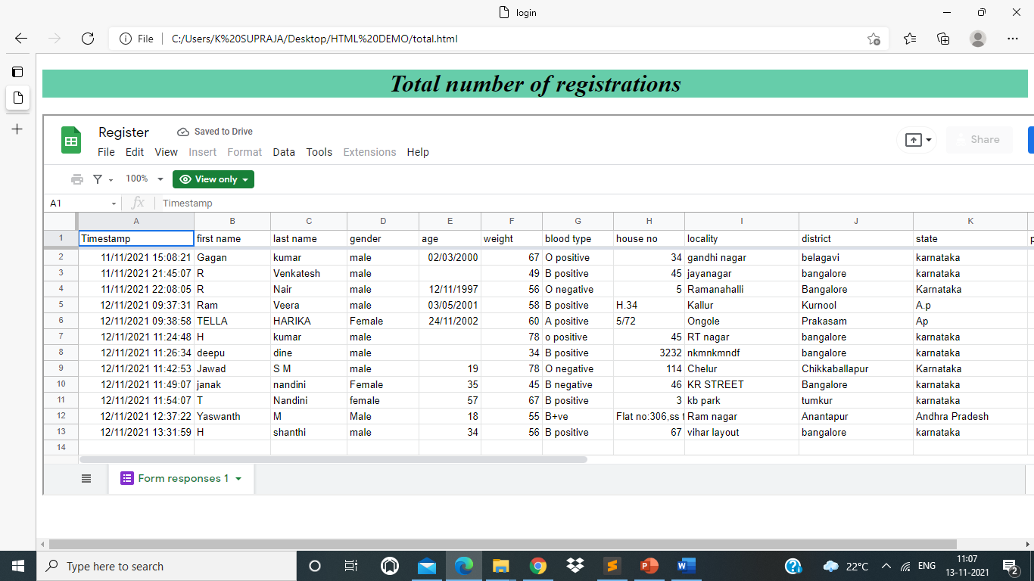
After successful registration of a person , the data of the person is collected under total number of registrations.

Slide 8
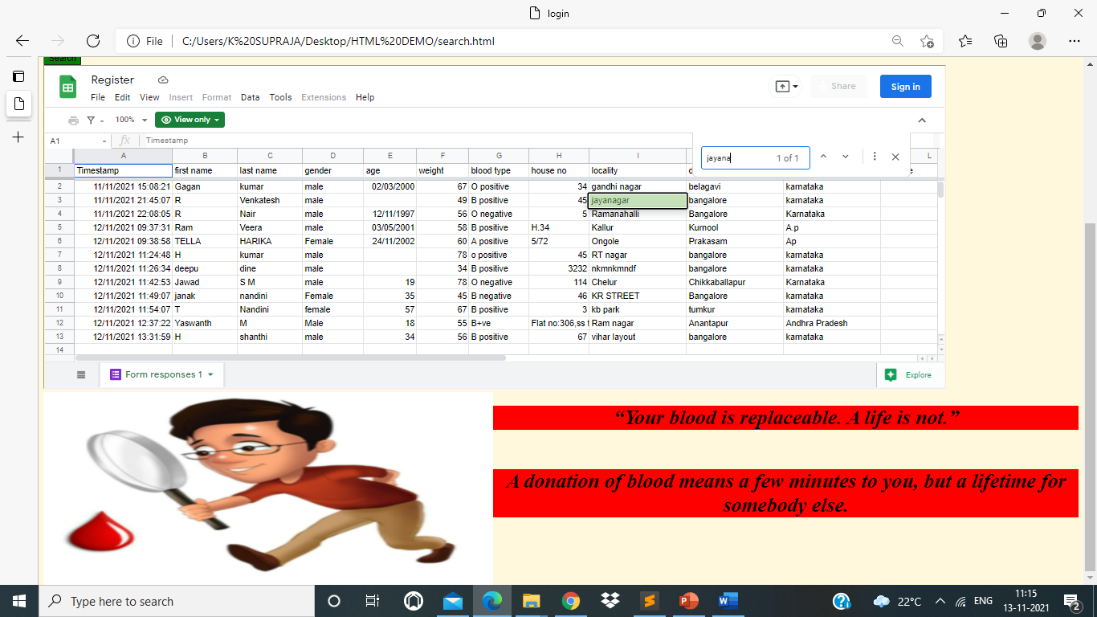
Search The people who are in need of blood can search for the people near them , who has registered as a donor and can save the lives of the people.

Slide 9

Donate your blood for a reason, let reason to be life

Slide 10

THANK YOU

